Slide 1
F5 / NGINX
RedHat & NGINX Automation Deep-Dive

Slide 2
Agenda
Automation recap
Automating with Ansible Tower and NGINX Controller
Using Ansible with Kubernetes
Securing Ingress with Custom Resources
Demo

Slide 3
Recap
Quick recap on the previous session

Slide 4
Automating with Ansible
Tower and Controller

Slide 5
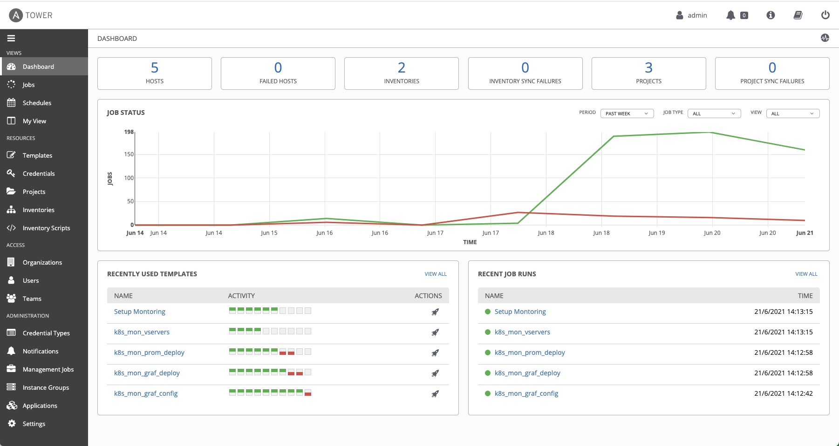
Ansible Tower
Enterprise Automation
Enterprise features for Ansible
Link projects direct from SCM
Integrate with Secure Credential Storage
Integrations with:
Ansible Galaxy
RedHat Automation Hub
Schedule plays
RBAC for Security

Slide 6
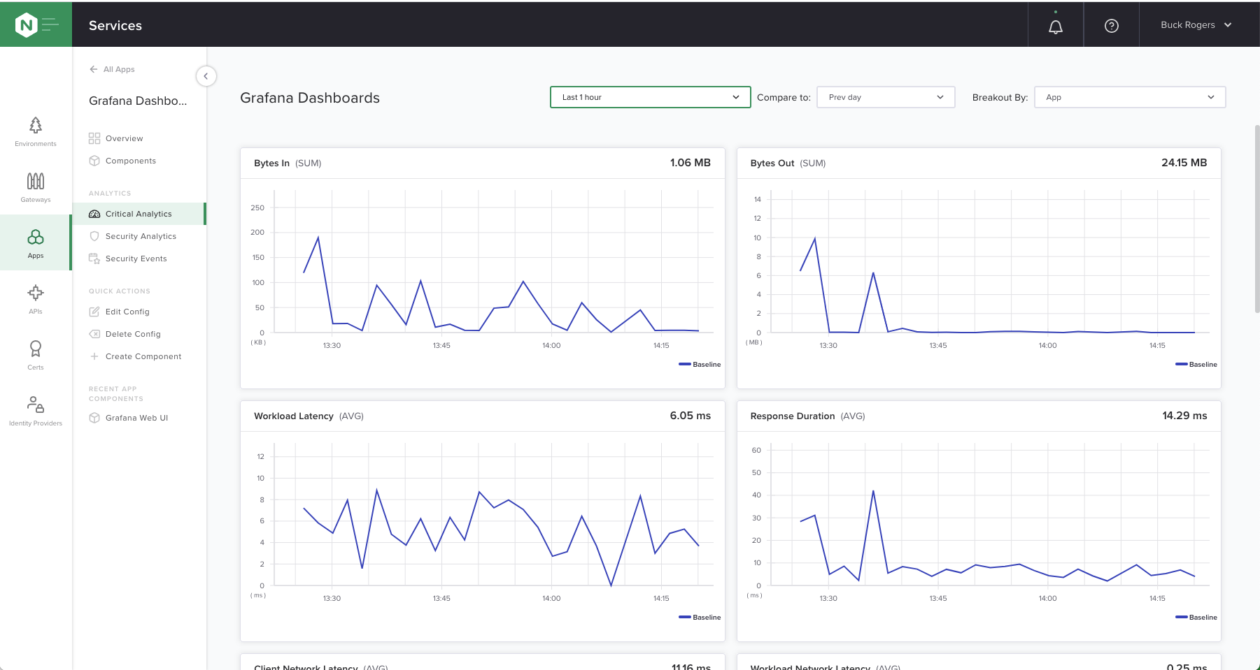
NGINX Controller
Enterprise Automation
Enterprise features for NGINX Plus
Declarative API for pipeline integration
High level abstraction for ADC/APIM
Metrics collection and forwarding
WAF (NGINX App Protect) Management
RBAC for Security

Slide 7
Automating Kubernetes
Ansible with Kubernetes

Slide 8
Kubernetes Components
Source: https://kubernetes.io/docs/concepts/overview/components/
Notes:
Kubernetes is a container orchestration platform built around a central API server. DevOps interact with the API to create objects or resources in the K8s platform. Everything is a resource: deployments, pods (containers), services, secrets, etc. Resource created through the API are placed in the etcd store, and controllers then work to deliver on the resource requirements, some of which is deploying containers into pods, and scheduling them on one of the worker nodes.

Slide 9

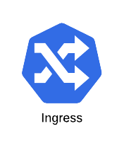

Kubernetes Control Loop
“In Kubernetes, controllers are control loops that watch the state of your cluster, then make or request changes where needed. Each controller tries to move the current cluster state closer to the desired state.”
“In robotics and automation, a control loop is a non-terminating loop that regulates the state of a system.”
Source: https://kubernetes.io/docs/concepts/architecture/controller/
Notes:
So, Kubernetes is made up of a whole host of different API specifications (or Resource definitions), and daemons known as “Controllers” manage those resource.
This is where the term Ingress Controller comes from. It’s the “Controller” for managing “Ingress” resources.

Slide 10
Kubernetes Ingress vs Custom Resources
Kubernetes Ingress
HTTP layer 7 routing based on host header and paths
TLS termination (officially no re-encryption)
Advanced features need to be enabled via:
Annotations
ConfigMaps
Extensions via annotations are not validated
CRs are fully validated within K8s API
HTTP layer 7 routing based on all application data (Host, Path, Cookie, Header, Method, etc)
Support for HTTP2, GRPC, TCP, UDP
Application security (WAF support)
Layer 7 traffic policies (rate limit, ACL, etc.)
Traffic splitting, Blue/Green, Canary
Circuit breaker patterns
Custom Resources
Notes:
The Ingress spec provides support for HTTP(S) services, and routing based on only Host header and Path.
Officially it only supports TLS termination, not re-encryption.
So, what’s happened over time is vendors of the various Ingress Controllers have developed their own customizations to add extra features. Using configmaps and annotations, but these aren’t validated by the k8s API.
The lack of validation is a problem when you want to be making releases and updates through CiCD pipelines, because there’s no immediate feedback if an annotation includes an error.
Custom Resources solve this problem by providing and alternative method for exposing services. They take advantage of the extensible nature of the K8s API. We register new resources which can have full validation by the K8s API, and expose many more advanced features at the same time.
An added benefit is that the CRD’s are all first class objects in the API and so benefit from the Kubernetes RBAC system. A KIC that has a WAF for example can restrict policy generation to the SecOps team.

Slide 11




Secure Self Service with Custom Resources
David
NetOps
Olivia
DevOps
Tony
AppDev
Alice
SecOps
RBAC Enabled
Custom Resources for ingress:
Security policies
Service protection policies
Virtual server
Application routing
Ingress Link

Slide 12
Demo’clock

Slide 13
Summary
Hopefully the demo went well
Ansible Tower
Automation of traditional infrastructure and modern container platforms
Configuration Management
Ansible Collections
NGINX Ingress Controller provides a better Kubernetes Ingress by:
Not using Ingress ☺
Deployable on K8s and OCP with a life-cycle operator
Custom Resources inherit RBAC
Brings all functionality into a well defined API Spec

Slide 14
Qs and As
And links….

Slide 15
Any Questions….
RedHat Tekton: https://tekton.dev/

Slide 16
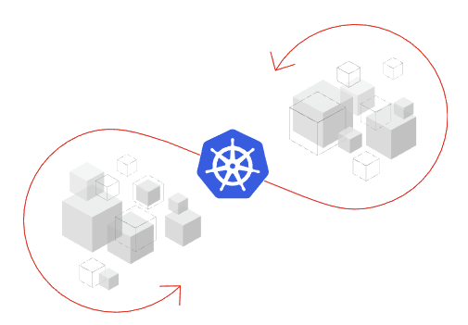
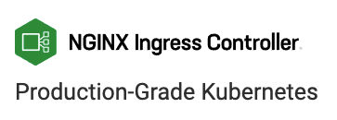
Kubernetes Extensibility
Custom resource definitions
OpenShift Pipelines is a Kubernetes-native CI/CD solution
Built on Tekton
Adds CI/CD pipeline functionality via Custom Resources.
OpenShift Operator for Life-Cycle Management
NGINX Ingress Controller
Provides the “Control Loop” for standard Ingress Resources
Also provides for NGINX Custom Resources
OpenShift / K8s Operator for Life-Cycle Management

